Slide 1

Biological Assessment
Christian Wolter
Leibniz-Institute of Freshwater Ecology and Inland Fisheries
REFORM Summer School, Wageningen (NL), 28 June 2015

Slide 2
Aim
Learn about the what and how
to assess ecologic effects of hydromorphological change, degradation and rehabilitation
Taxa
Indicators & metrics
Methods
Application
Notes:
The lecture provides overview on potential indicator taxa, metrics, methods and its application to assess ecologic effects of hydromorphological change, degradation and rehabilitation

Slide 3
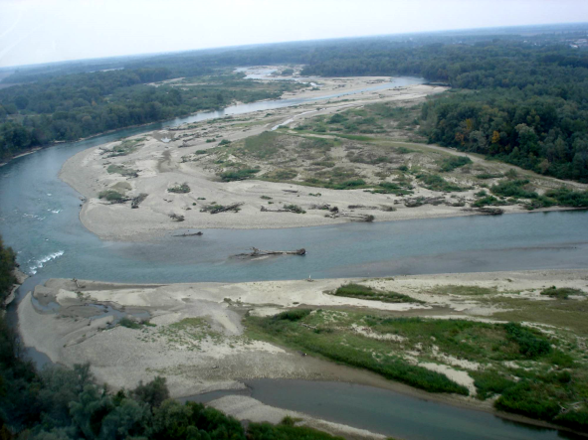
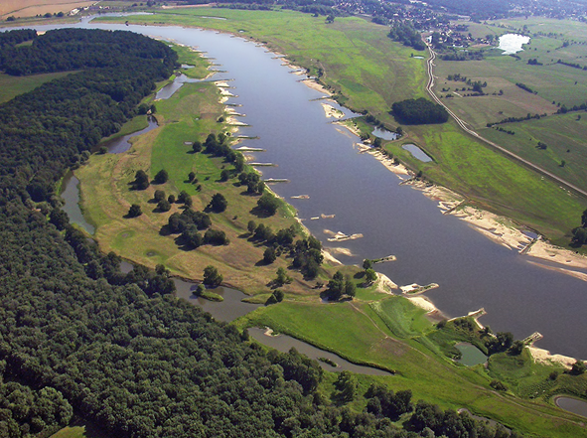
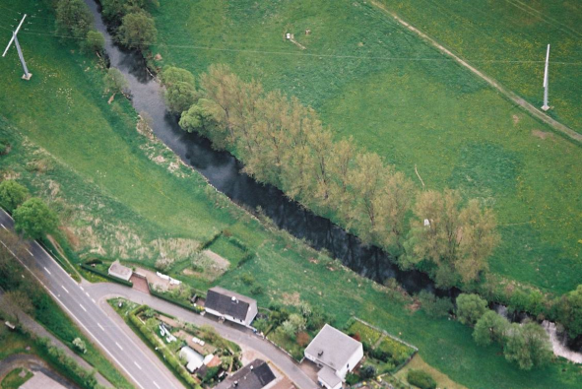
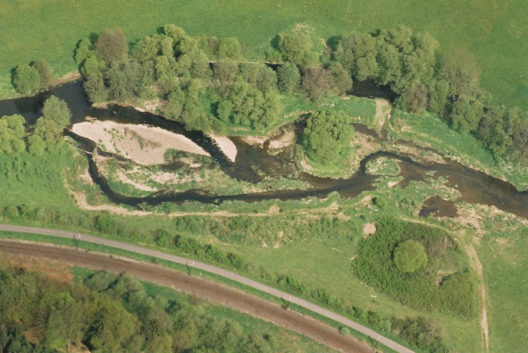
Aim
What is lost or gained? How do biota respond?
Kuban, Foto: Sukhodolov
Elbe, Foto: Pusch
What should be measured and how?
Lahn, Foto: Hering
Lahn, Foto: Hering
Notes:
Which hydromorphological processes are disturbed or interrupted, which hydromorphological habitats are lost or degradation, respectively which processes and/or habitats are rehabilitated? How will biota respond, which taxa, species, traits; and thus, what should be measured and assessed, how and where?

Slide 4
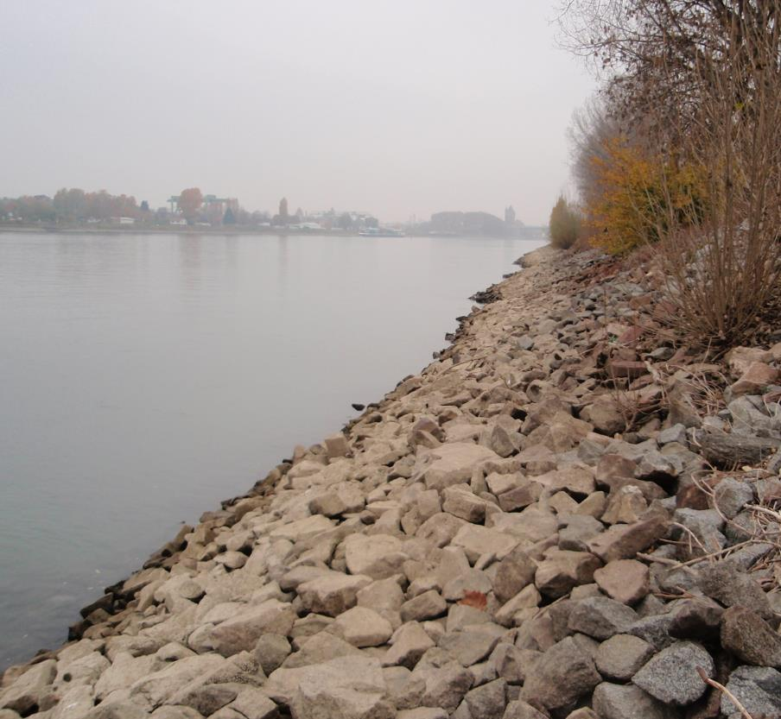
What is lost
Littoral habitats
Habitat complexity
Large wood
Depth & width variability
Flow velocity patterns
Lateral connectivity
Flood plains

Slide 5
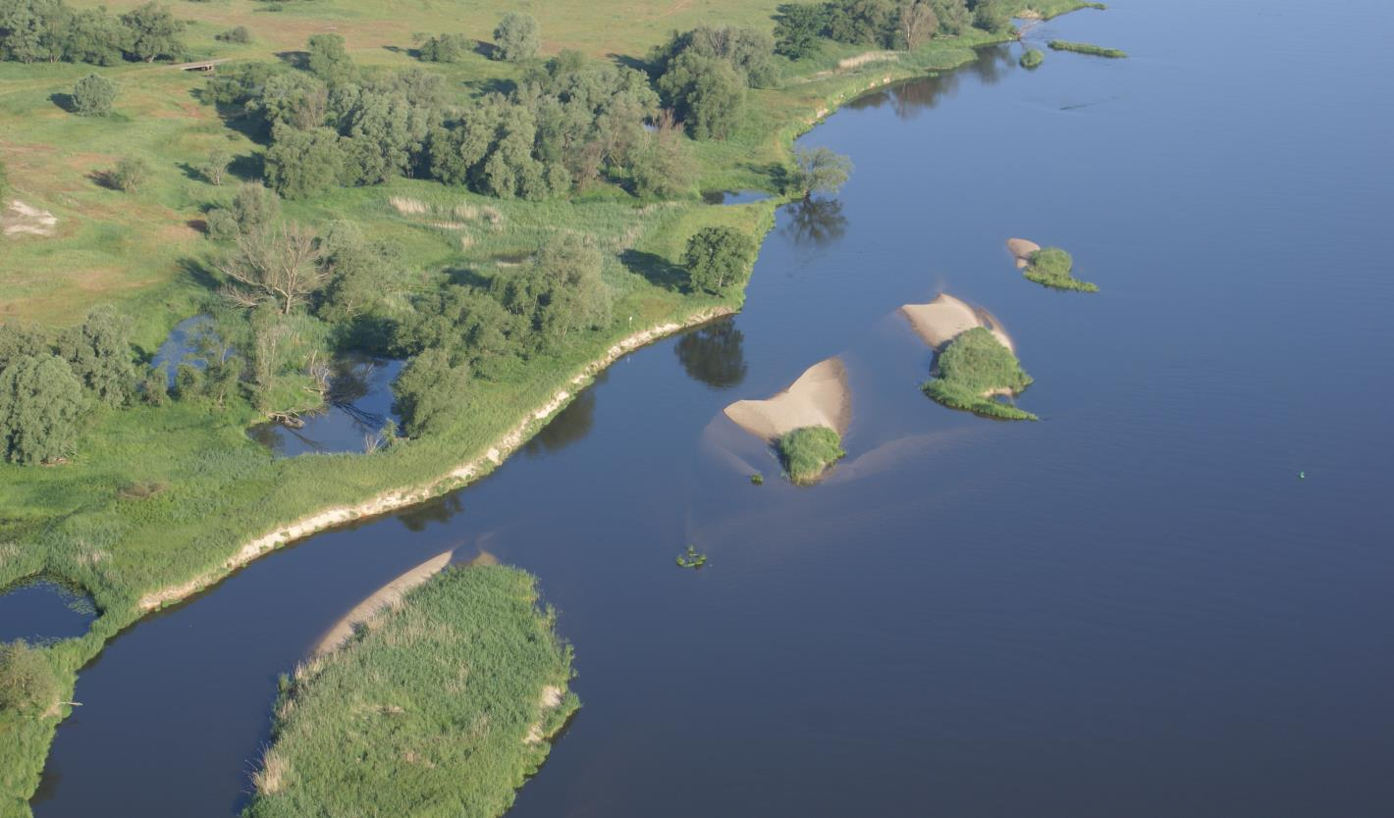
Who is affected
Floodplain vegetation
Riparian vegetation
Amphibians
Mussels
Snails
Carabid
beetles
MI
Juvenile
fish
Aquatic
plants
Macroinvertebrates
(MI)
Adult
fish
Adult fish
Notes:
In bold: obligatory biological quality elements for the WFD

Slide 6
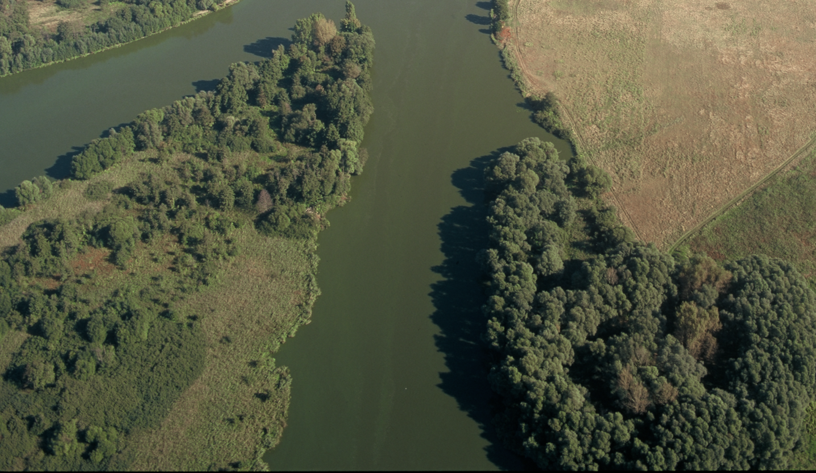
How to sample
Floodplain vegetation
Transects through the active floodplain
III
II
I
I
II
III
Foto: WSA Brandenburg
Notes:
Time: June-July (summer, vegetation period), 10 transects along a 200 m (<50 m wetted width) to 500 m (>50 m wetted width) river stretch; determine length of vegetation units along transects
Divide each transect in regular sub-zones (3 at each bank), randomly distribute 12 sample plots per transect to determine vegetation cover (%) within plots

Slide 7
How to sample
Riparian vegetation
10-30 m buffer stripes along the river margins
100 m
100 m
100 m
Foto: WSA Brandenburg
Notes:
Time: June-July (summer, vegetation period), 10-30 m buffer stripes along the river margins, depending on the width of the riparian buffer; determine % cover of main vegetation units in 100 m stretches (overview can be performed along several km or entire rivers, also from aerial photographs). Randomly distribute sample plots within the riparian buffer to determine exact vegetation cover (%) within plots

Slide 8
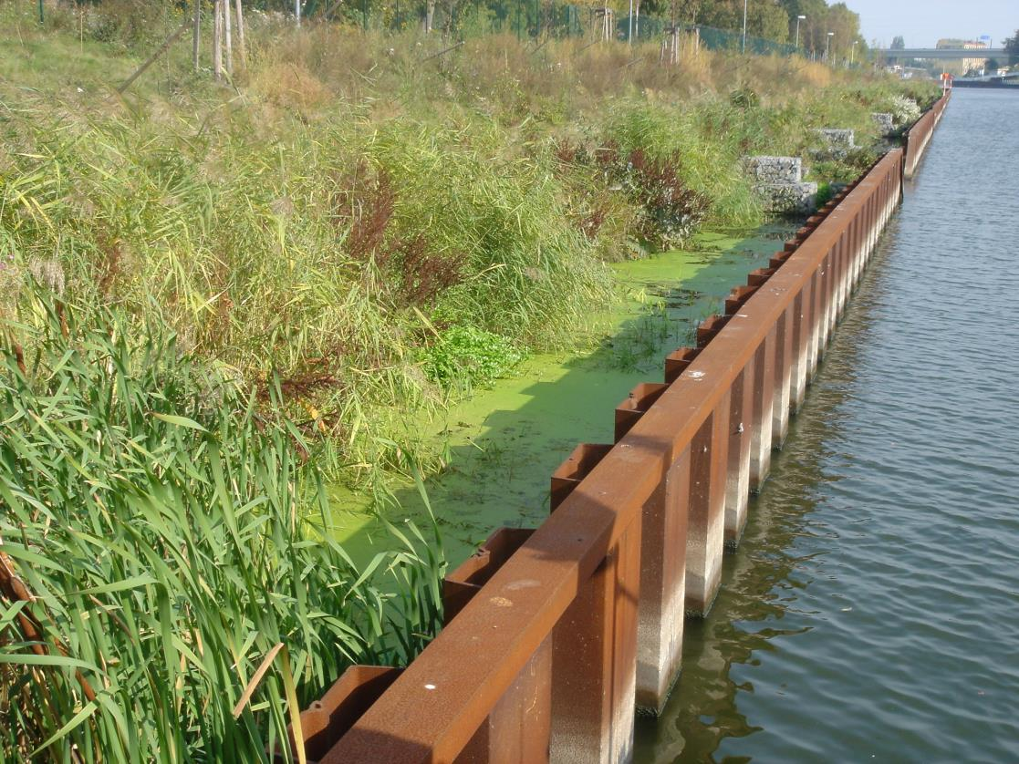
How to sample
Aquatic vegetation
Hydrophytes
& helophytes
Helophyte abundance
Weber et al. (2012)
Notes:
Time: July-August (summer, vegetation period), maximum vegetation development, max. plant biomass. Spatial coverage (%) and height within the water column (%) of submerged macrophytes, dominant species (overview) and detailed species composition; hydrophytes (=submerged & floating-leaved) & helophytes (=emergent plants); helophyte abundance in 3 equally spaced transects / stripes along the banks from 20-50 cm below the average water level to 20-50 cm above

Slide 9
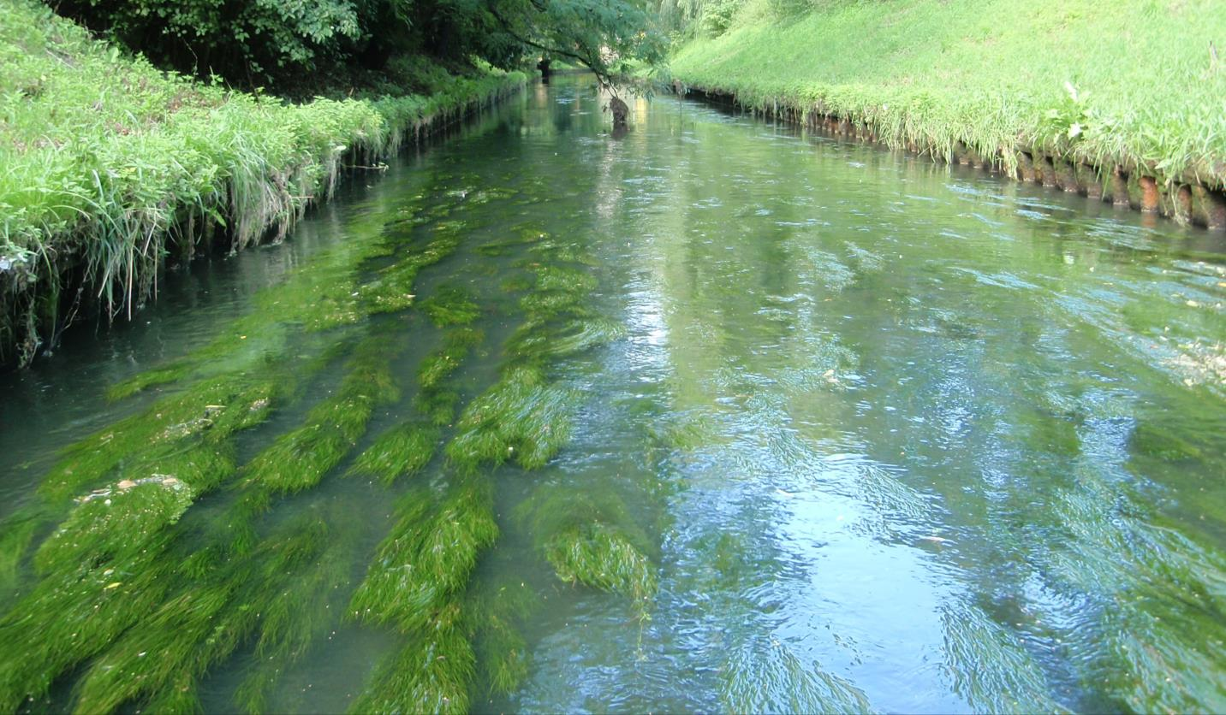
How to sample
Aquatic vegetation
Notes:
Time: July-August (summer, vegetation period), maximum vegetation development, max. plant biomass. Equally spaced transects or zigzag course along a 200 m stretch to determine hydrophyte coverage (%), growth forms, species or taxa, and average height in the water column

Slide 10
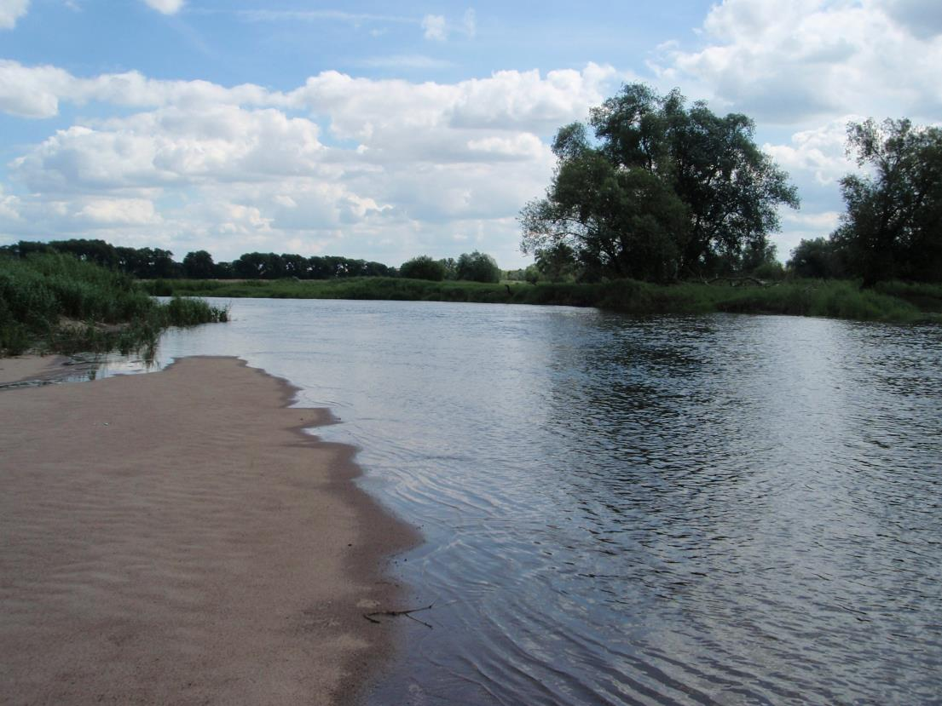
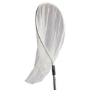
How to sample
Riparian beetles
pitfall traps
Pitfall trap
(source REFORM sampling protocols)
Hand collection
Notes:
Time: late June to early August, at low discharge. mesohabitat-specific sampling in a max. 10 m wide stripe of the riparian areas of each sample section; only mesohabitats with ≥10% coverage; 10 samples per stretch according to mesohabitat proportion (summing up to 100%).

Slide 11
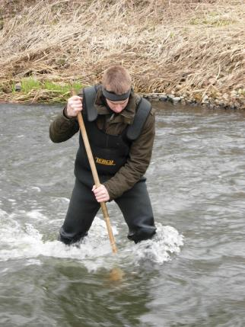
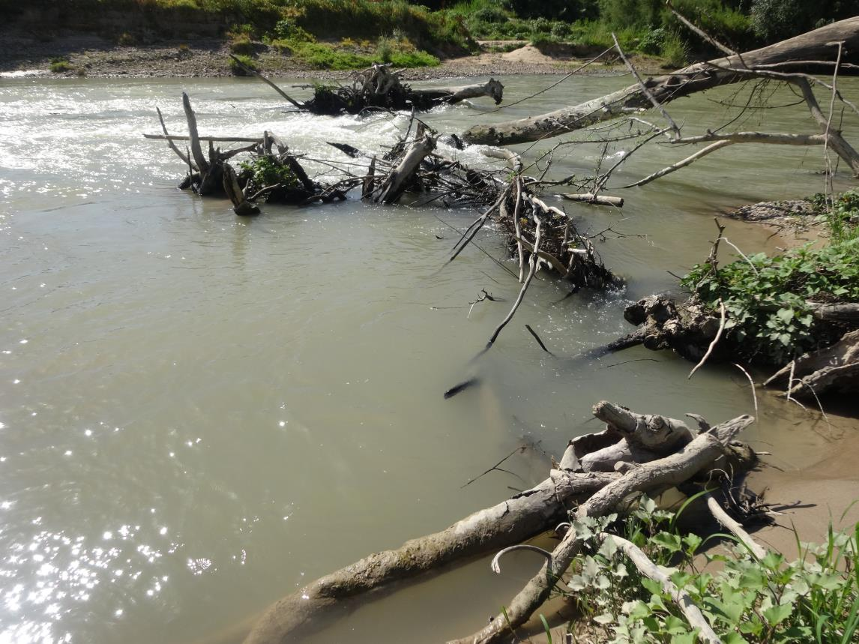
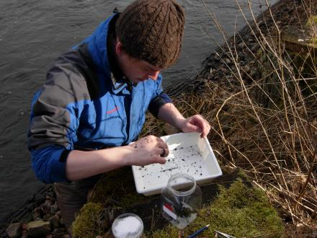
How to sample
Macro-Invertebrates
Notes:
Time: March to August, multi-habitat sampling along 200-500 m river stretches, sampling stratified according to the available substrates ≥5% coverage; per stretch distribute 20 independent samples of 25 * 25 cm (1.25 m² in total) according to the share of microhabitats in 5% steps (30% coverage = 6 samples); include all substrates ≥5% coverage

Slide 12
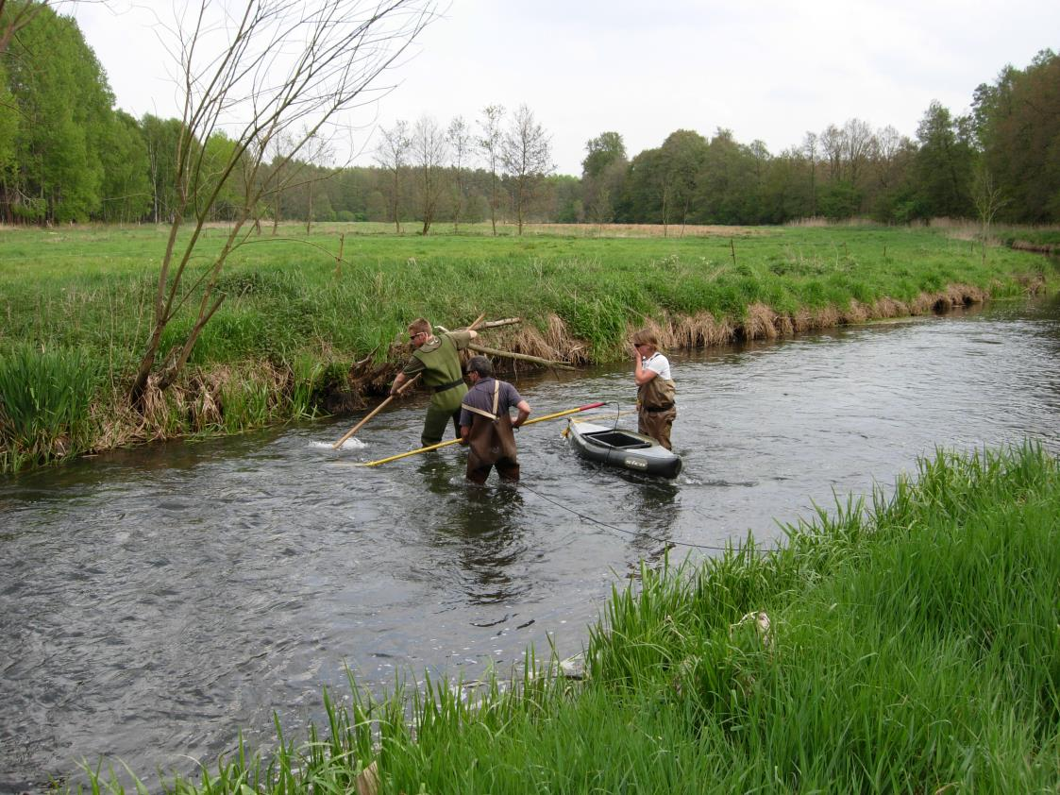
How to sample
Fish
Standard electric fishing
Wading:
1 anode per 5 m wetted width
Boat:
1 anode along the banks
Single pass
Notes:
Time: for WFD in late summer early autumn at low discharge condition; cover all available meso & macrohabitats; min length fished 100 m; min. length to catch all species with 90% probability 400 m; min number of fish caught 101

Slide 13
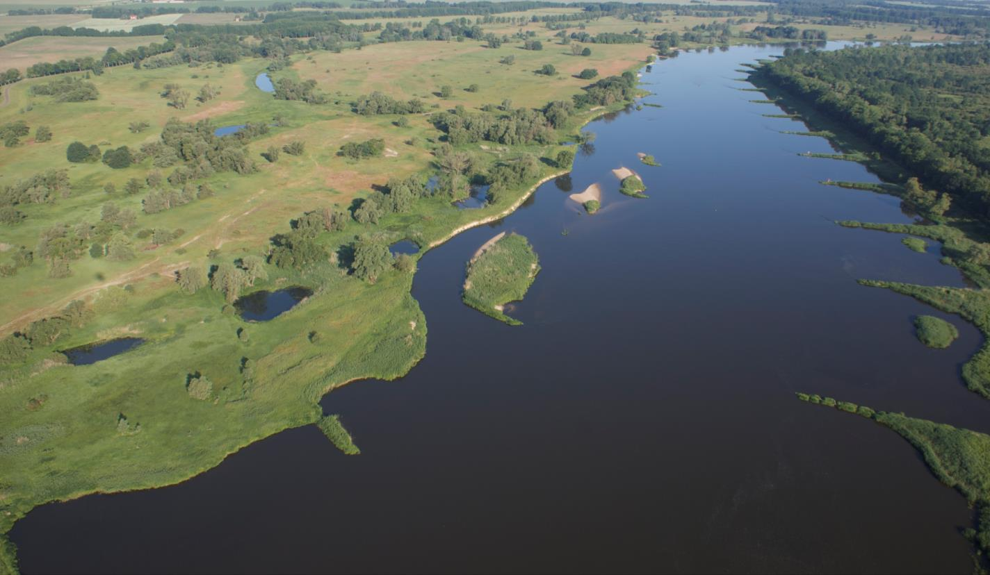
How to sample
Fish
Potential electric fishing stretches
Notes:
Random stratified sampling, strata defined by water body and dominant fish ecologically relevant habitat structures

Slide 14
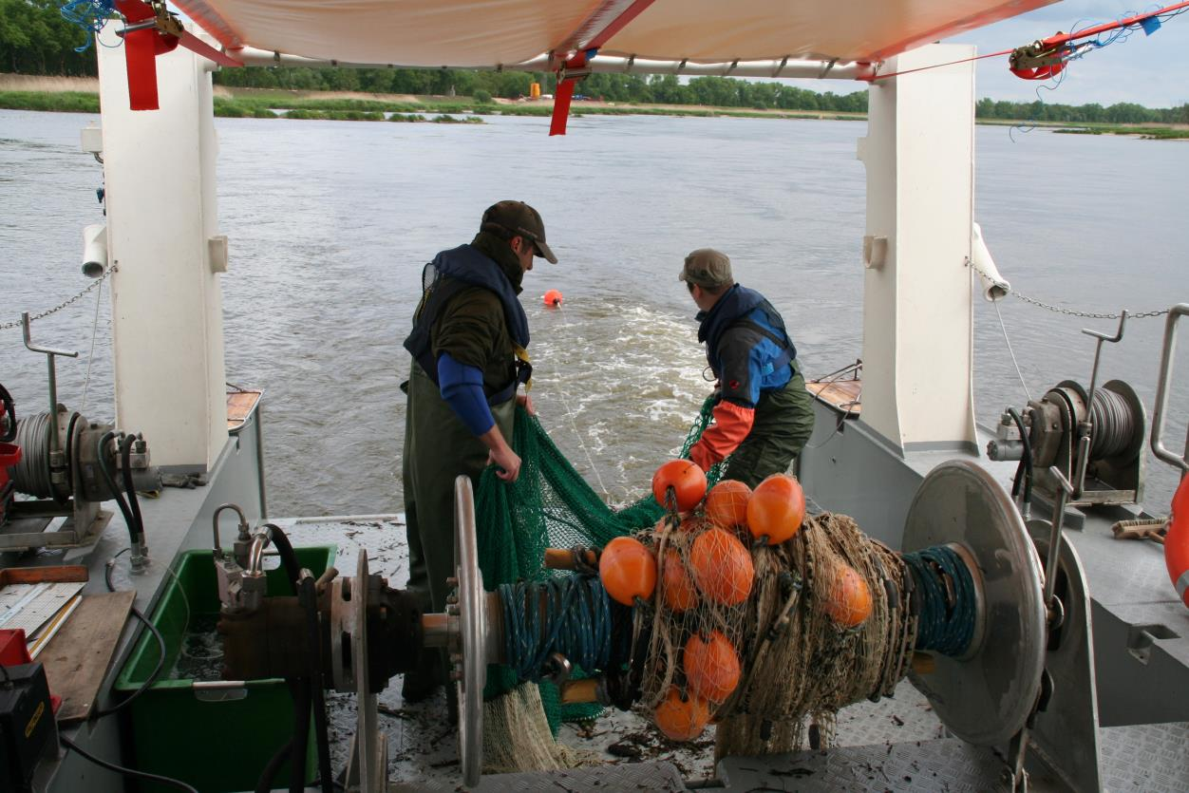
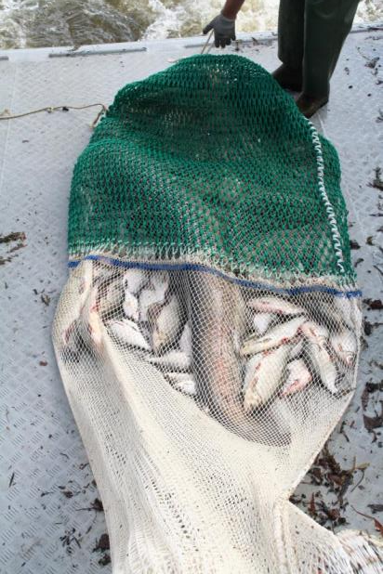
How to sample
Fish
Add. gears in large rivers
Notes:
Trawl fishing in the mid-channel section of a large river

Slide 15
Methods overview
Sampling objectives determine effort
1. Biodiversity / species inventories
All gears/sources of evidence; qualitative sampling; all habitats, seasons, …; highest species identification efforts
2. Stock development / abundance trends
Species of interests only; standardised gears / sampling; quantitative sampling; time series
3. Status assessment / measure evaluation
Indicator taxa; standardised gears / sampling; quantitative sampling; all habitats; BACI
Notes:
BACI= before-after, control-impact study design to evaluate rehabilitation measures etc.; focus in the following is on status assessment according to the WFD using the WFD metrics and indicators

Slide 16
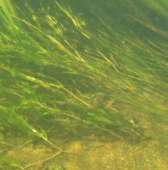
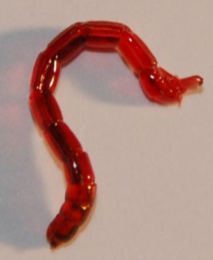
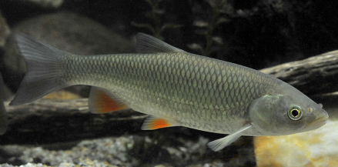
Methods overview
European methods
21 macrophyte-based assessment schemes
Metrics: abundance, biomass, composition, diversity, growth forms
29 benthic inverts assessment schemes
Metrics: abundance, biomass, composition, diversity
20 fish-based assessment schemes
Metrics: abundance, biomass, composition, diversity, age structure

Slide 17
Status assessment
Indicators
Biomass
Abundance
Benthic
inverts
Cyprinid
fish
Submerged
plants
Emerged
plants
Coregonid
fish
Percid
fish
oligotrophic
Water quality
hypertrophic
Notes:
Biomass and abundance in general primarily respond to productivity, availability of nutrients; positively related to nutrient content until limitations of both light and oxygen cause decline; in headwaters, there is also a correspondence between abundance/biomass (especially of fish) with habitat complexity

Slide 18
Status assessment
Indicators
Diversity
Growth forms
(plants)
Species
composition
Age structure
(fish)
low
Habitat complexity/diversity
high
Notes:
Species diversity, plant growth forms, and juvenile fish are positively related to habitat diversity and habitat complexity; in headwaters, there is also a correspondence between habitat complexity and abundance/biomass especially of fish (provision of shelter, increase of carrying capacity)

Slide 19
Status assessment
Indicators
Aquatic
plants
Benthic invertebrates
Fish
rheo-philic
limno-philic
rheo-biont
larvae
juv
adults
0.3
0.7
1.0
2.0
Flow velocity (m/s)
Notes:
High flow velocities will taxa-specifically limit habitat use; prevent weak swimmers from habitat utilisation; fragile growth forms of plants disappear at moderate stream power;

Slide 20
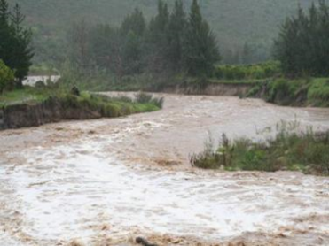
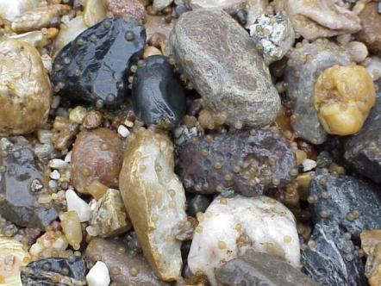
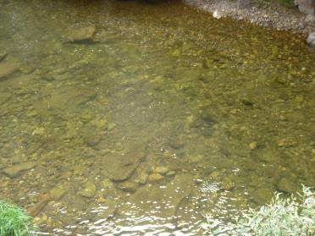
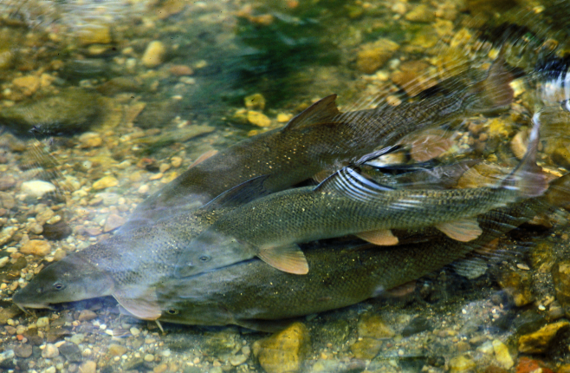
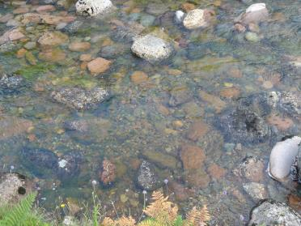
Status assessment
Indicators
More specifically …
… gravel preferring and gravel-depending species
e.g., lithophilic fish, gravel spawner with benthic larvae
Foto: Jörg Freyhof
Notes:
Stream power drives sediment transport and sorting, and provides and maintains coarse substrates (gravel); species depending on or preferring gravel substrates provide specific indicators for functioning substrate maintenance by stream power

Slide 21
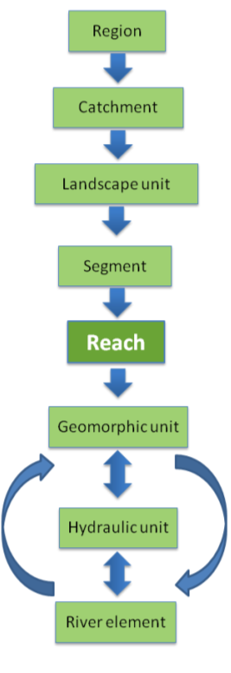
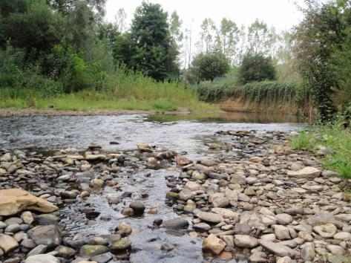
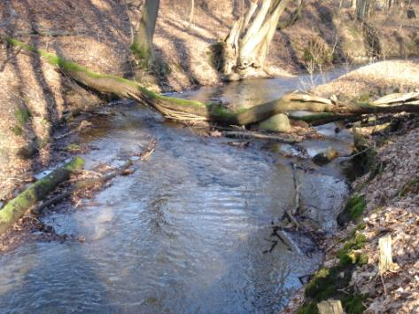
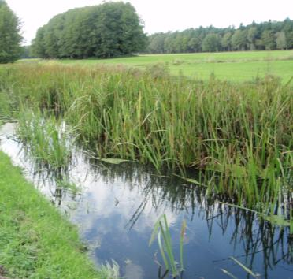
Status assessment
Indicators
More specifically … at the reach level
Fish assemblage integrates over functional process zones
Notes:
River reaches have characteristic sets of geomorphic and hydraulic units forming functional process zones that support characteristic species assemblages; fish are in particular suitable indicators at the reach level due to their mobility, relative longevity, and variable habitat use; fish integrates over smaller units and their spatio-temporal variation within the functional process zone

Slide 22
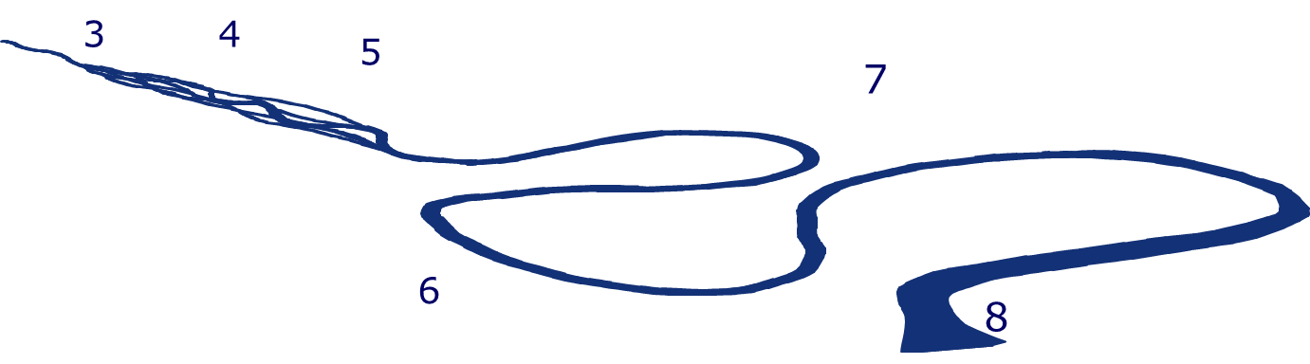
Functional process zone
Fish zonation
Fish Region Index
Notes:
FRI indicates the probability of presence of a certain species within a river reach; FRI characterises the preference of a species for a certain river region, the variance of FRI indicates its spread over regions; the preference of lampreys and fish for a certain river reach serves as species-specific diagnostic character; FRI can be used to calculate the whole assemblage FRI of a sample

Slide 23
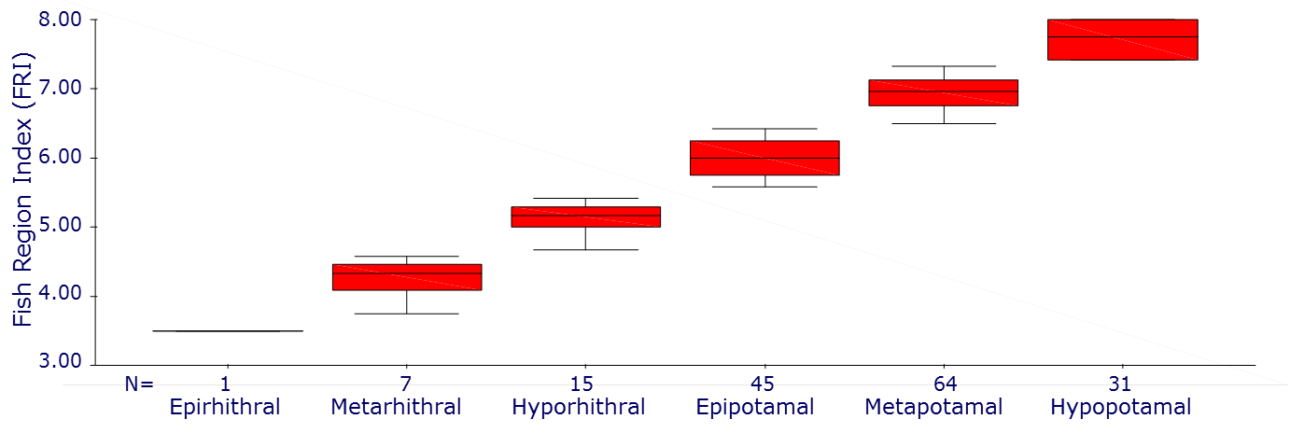
Functional process zone
Fish zonation
Number of region-specific species
Notes:
FRI indicates the probability of presence of a certain species within a river reach; FRI characterises the preference of a species for a certain river region, the variance of FRI indicates its spread over regions; the preference of lampreys and fish for a certain river reach serves as species-specific diagnostic character; FRI can be used to calculate the whole assemblage FRI of a sample; main advantage: FRI of assemblages can be directly compared between rivers and regions independently of the local species pools

Slide 24
How to assess what
Riparian vegetation
Floodplain vegetation
Amphibians
Mussels
Snails
Carabid beetles
Juvenile
fish
Objectives
Indicators
Sampling strategy
Sampling sites
Macroinvertebrates
Aquatic
plants
Adult
fish
Notes:
Biological assessment requires 1) precise definition of objectives, 2) selection of the most appropriate indicators (taxa, functional groups, metrics), 3) use of appropriate methods and sampling strategy, and 4) identification of representative sampling sites

